Slide 1
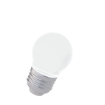
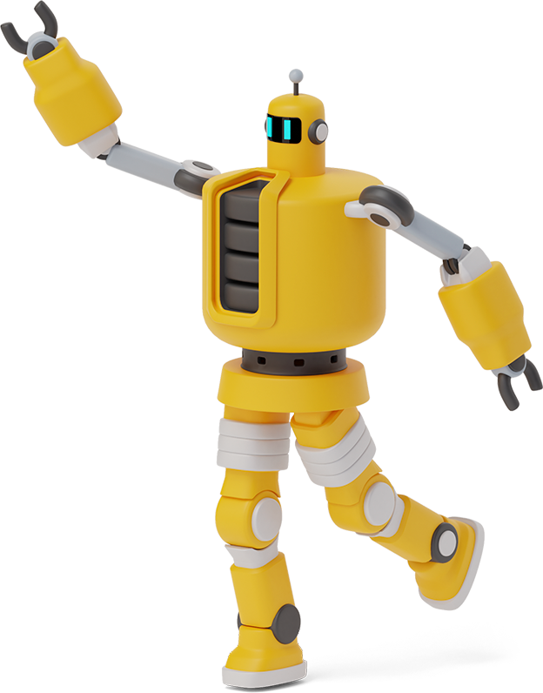
Team 7: 501 Dalmations
Rbe 501 lab COURSE
Developed By:
Kevin Boenisch, Meha Mohapatra, Nicole Kuberka & Sriranjani Kalimani
Notes:
nicole

Slide 2
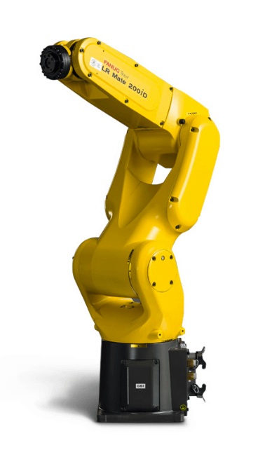

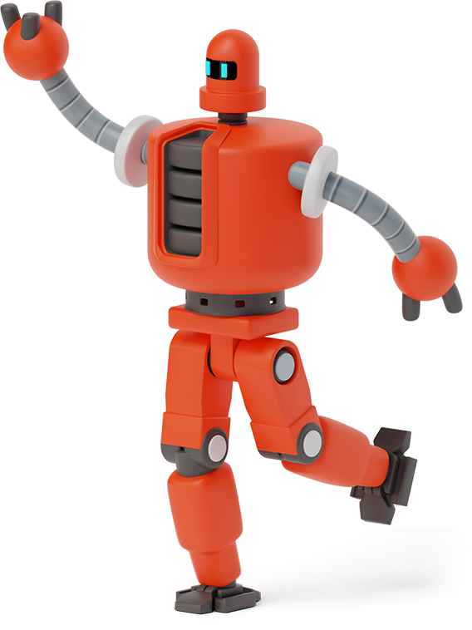
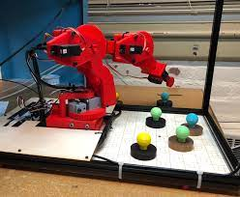
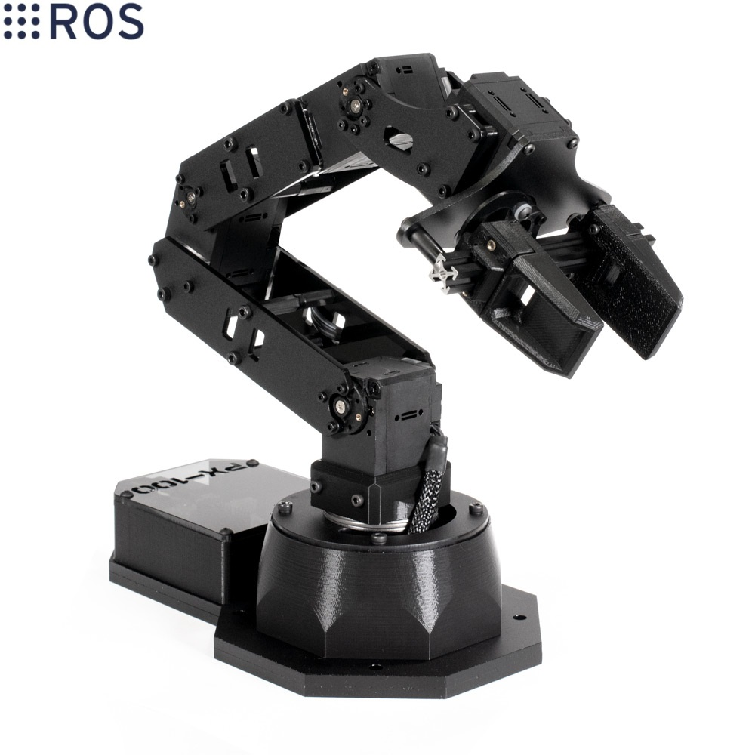
Overview
We created a lab course for RBE 501 similar to RBE 3001 - an undergraduate course offered at WPI.
Robot Model Inspired By:
Hephaestus Arm 2(RBE 3001)
Other Industrial Arms
FANUC LR Mate 200 iD
Hephaestus Arm 2
PincherX 100 Robot Arm
Notes:
meha

Slide 3
Robot Design
X4,5,6
X3
X7
Z4,6
L4 = 35.6mm
L3 = 150mm
Z7
Z5
Z3
L2 = 120mm
1 Spherical Wrist
X2
3 Rotational Arm Joints
DH PARAMETERS
Z2
 | θ | d | a | α
1 to 2 | θ1 | L1 | 0 | -π/2
2 to 3 | θ2 - π/2 | 0 | L2 | 0
3 to 4 | θ3 | 0 | 0 | -π/2
4 to 5 | θ4 | L3 | 0 | π/2
5 to 6 | θ5 | 0 | 0 | -π/2
6 to 7 | θ6 | L4 | 0 | 0
L1 = 95mm
Z1
X1
Y1
Notes:
meha

Slide 4
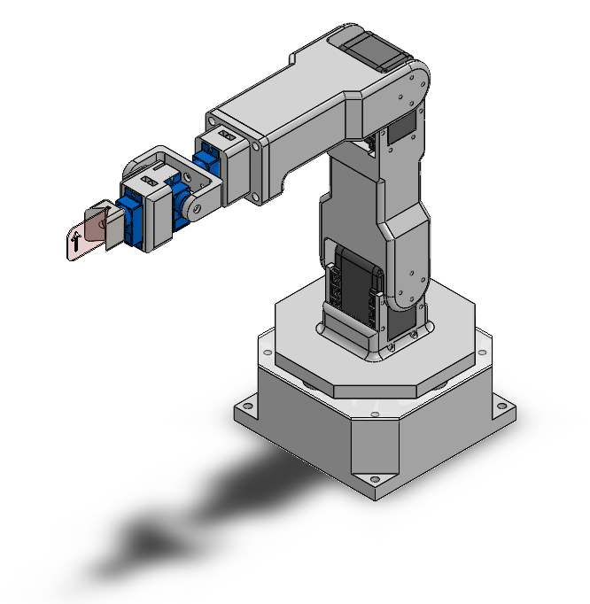
Robot Design cont.
MOTOR SELECTION
3 Arm Joints → Torque Control
3 Wrist Joints → Torque Control
Allows for more lab emphasis on dynamics
LENGTH SELECTIONS
Small enough for each student to own
Rapid Prototyping
Notes:
kevin
We took inspiration from 3001 blah blah blah covid

Slide 5
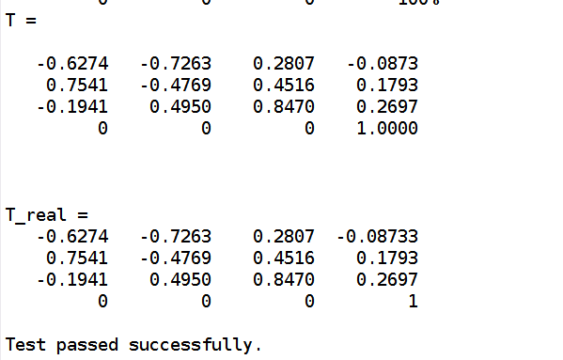
Robot setup Validation
T → matrix from screw axes
T_real → matrix from robot setup (dh)
Since T == T_real, setup and screw axes are correct
Notes:
sri
Show that dh, screw axis, and robot are compatible
Fwkin, ikin, etc. assertion passes

Slide 6
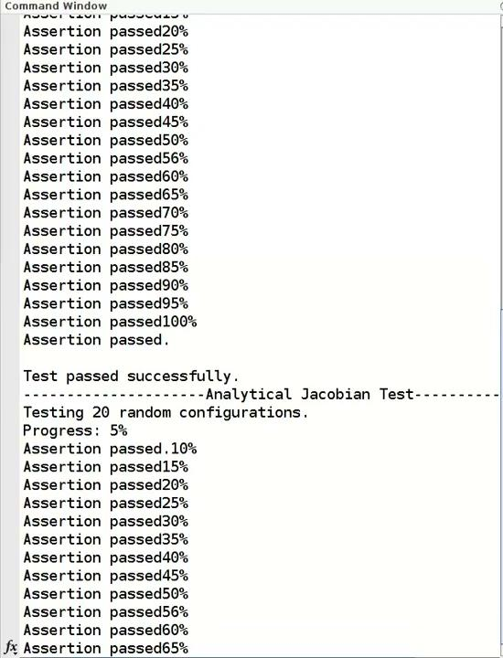
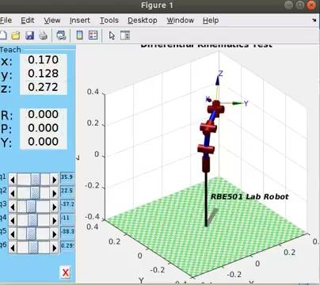
Robot setup Validation
Notes:
sri
Show that dh, screw axis, and robot are compatible
Fwkin, ikin, etc. assertion passes

Slide 7
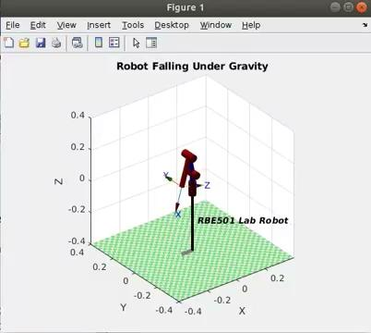
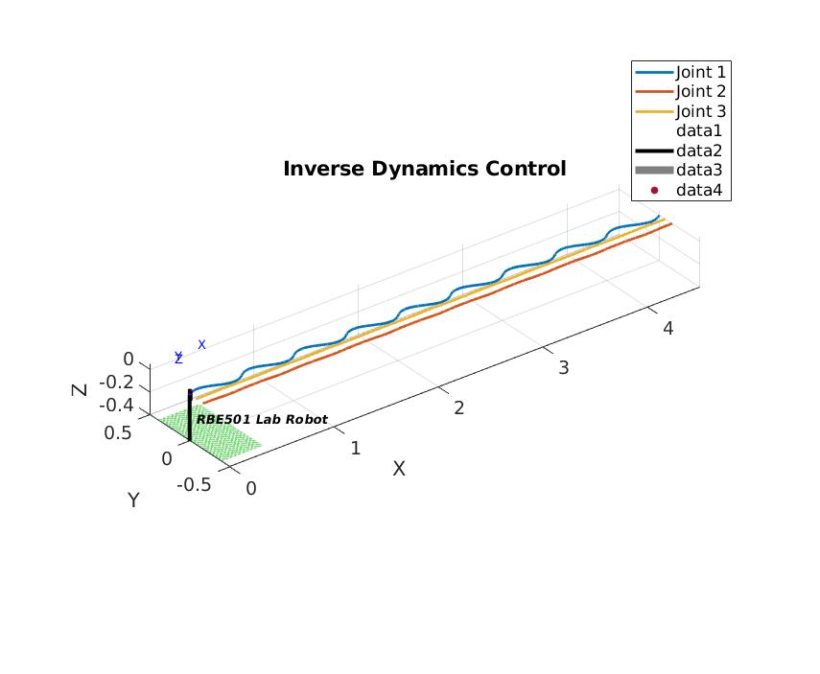
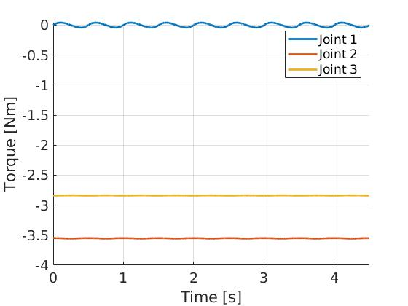
Dynamics Validation
Notes:
sri

Slide 8
Course Design
Overall
Labs will build on each other
Students are given an objective & lab specific stub files
Students will deliver a focused lab report & do a physical implementation
Lab 1 Basic Kinematics in Space Frame
Lab 2 Basic Kinematics in Body Frame
Lab 3 Dynamics
Lab 4 Pick and Place
Notes:
kevin

Slide 9
Lab 1: Basic Kinematics in Space Frame
OBJECTIVE: Complete Forward, Inverse, and Velocity Kinematics in the Space Frame
Given
RVC2
Completed Serial Link
Lab1.m template code
Stub function files
Assignment
Calculate screw axes
Calculate forward kinematics using POE
Calculate space jacobian
Calculate inverse kinematics
Lab Report
Explain how each function works
Explain how assert works
Explain singularities and you choose to avoid them
Physical Implementation
Forward kinematics
Inverse kinematics
Avoides Singularities
Notes:
kevin

Slide 10
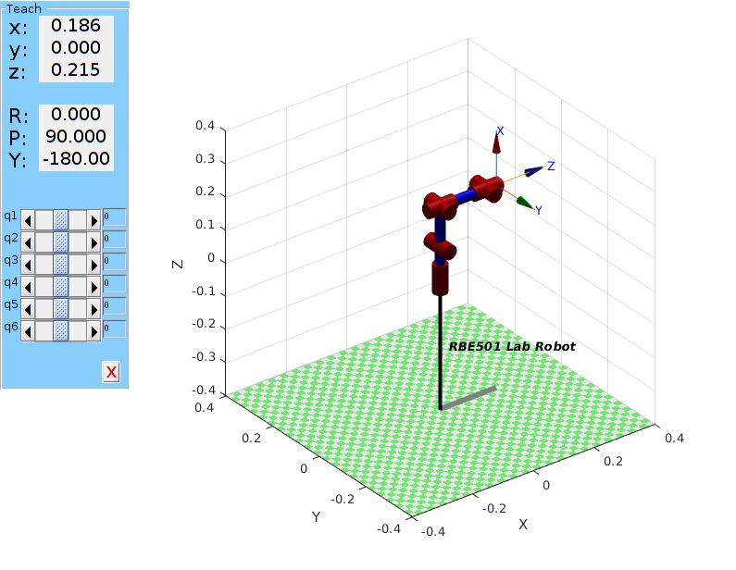
Lab 1: Basic Kinematics in Space Frame
Correctly setting up the robot
Notes:
kevin

Slide 11
Lab 2 : Basic Kinematics in Body Frame
OBJECTIVE: Complete Forward, Inverse, and Velocity Kinematics in the Body Frame
Given
RVC2
Lab2.m template code
Stub function files
Files from previous labs
Assignment
Calculate screw axes
Calculate forward kinematics
Calculate body jacobian
Calculate analytical jacobian
Calculate inverse kinematics
Lab Report
Explain how each function works
Explain the difference between space and body frame and why each perspective is important
Explain the value of the analytical jacobian
Physical Implementation
Forward kinematics
Inverse kinematics
Avoides Singularities
Notes:
meha

Slide 12
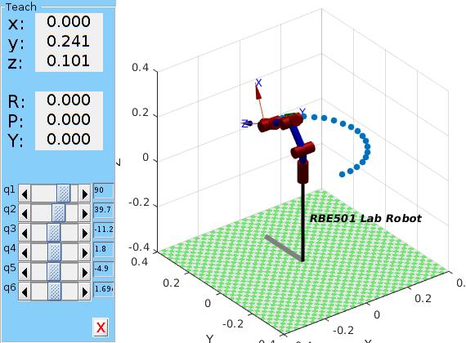
Lab 2 : Basic Kinematics in Body Frame
Inverse kin to trace a path
Notes:
meha

Slide 13
Lab 3 : Dynamics
OBJECTIVE: Understand the importance & how to calculate forward & inverse dynamics
Given
RVC2
Lab3.m template code
Files from previous labs
Assignment
Calculate transforms b/w links
Calculate spatial inertia matrices
Check forward dynamics
Check inverse dynamics
Calculate wrench to control motion
Lab Report
Explain what dynamics is and why it’s important to robotics
Explain each check/test’s value
Physical Implementation
Smooth motions to each setpoint
Assignments:
Check Forward Dynamics
Check Inverse Dynamics
Build Wrench to Control the Motion between Set Points
Notes:
nicole

Slide 14
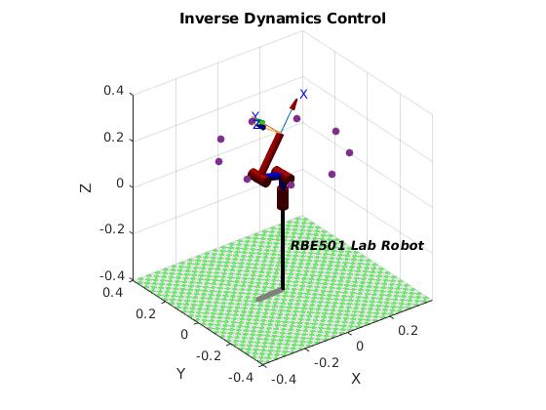
Lab 3 : Dynamics
Inverse Dynamics to smoothly trace a path
Notes:
nicole

Slide 15
Lab 4 : Pick and Place
OBJECTIVE: Combine previous knowledge with computer vision to sort objects
Given
RVC2
Files from previous labs
Built-In Matlab Camera Toolbox
Assignment
Calibrate Camera
Create masks
Calculate transformations wrt camera position
Develop fluid code to sort objects by size and/or color
Lab Report
Explain and show how calibration works
Explain and show process of sorting (combines computer vision and previous labs)
Physical Implementation
Sort plates by size and/or color
Notes:
sri

Slide 16
Future work
Lab Development
Create a pre-lab where students create the serial link
Quality Assurance
Create Lab Documents
Run through to ensure a balanced experience
Software Development
Create interface between Matlab & microcontroller
Hardware Testing
Better integrate servos
Test for wear and tear
Notes:
nicole
This project can be further expanded to better encompass everything in 501. Further development of programs to control the servos and creation of libraries would make the class easier to get going for the students in the first lab. Testing of the labs by Student Lab Assistants would need to happen to make sure the students have a balanced experience with enough challenge to learn the concepts without having to spend too many hours in the lab. Finally all the hardware would have to be put through more rigorous live tests over a long period of time to see if it can withstand multiple classes of students.

Slide 17
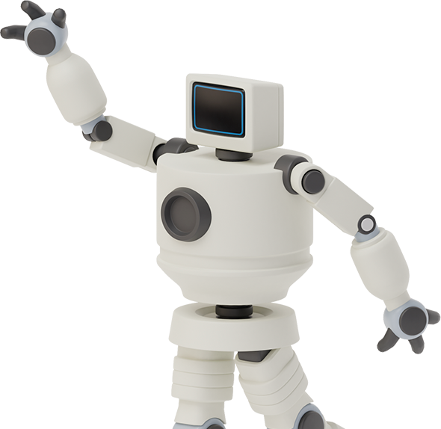

Thank you,
Any questions?

